Slide 1


“ Containers and their orchestration is the need of the day as they make the life of an engineer easy !
” — AK

Slide 2





Zero to Hero in Azure Container Ecosystem
by Abhishek Mishra
A community of Industry experts that runs a Monthly/Weekly series on -
Multi
Cloud
Engineering
Enterprise Cloud & Tech Learning
Multi Cloud learning, Niche Engineering, Extreme implementations and migration management.
Multiple Cloud & Technology Platform Partner
(Supported by cloud MVP & Team)
Data science learning
Data ware house, programming & extreme engineering
Free Certificate endorsed by real practitioners and goodies direct from cloud & tech companies.
Innovation
Data
& AI
Practice
Block
chain
Policy
Saturday and Sunday 11:30AM – 12:30PM IST, 9.00 PM to 10.00 Pm IST
Watch all our sessions at HTTPS://MULTICLOUD4U.COM/STREAMS

Slide 3




About Abhishek Mishra
Published Author, Speaker, Cloud Architecture – Azure, AWS, C# Corner MVP
14+ years of IT experience working across leading organizations in the industry
Cloud Architect – Intelligent Cloud, PaaS, Serverless & Automation
LinkedIn:-
https://www.linkedin.com/in/abhishek-mishra-4890909/

Slide 4

About Anjani Kumar
Multi decades of direct service to the
IT industry
Ex Publicis, RBS, Microsoft
Inventor, Leader, Mentor,
Founder and Enabler
LinkedIn:-
linkedin.com/in/anjanikkumar/
Chief evangelist:: Multicloud4U

Slide 5
Over to Abhishek

Slide 6

Agenda
Introduction to Containers
Azure Container Registry
Azure Container Instance
Web App for Containers
Azure Kubernetes Service
Azure Service Fabric
The Big Picture
Demo

Slide 7
Introduction to Containers
App1
App2
App3
Operating System Level Virtualization
Lightweight
Portable Across Environments
Easy to adapt
Container Engine
Operating System
Infrastructure

Slide 8


Azure Container Registry
Repository for Container Images
Facilitates versioning of images using Tags
Private Docker Registry
Stores related contents like Helm Charts and
Supports images built using Open Container Initiative (OCI) specification
Several ways to push images to Azure Container Registry
Highly Scalable and Available
Integrates well with DevOps Pipelines

Slide 9

Azure Container Instances
Fastest and simplest way to run a Container on Azure
Spins up and shuts down in no time
Do not need any VM or any other service to run a Container
Best fit for Single Container application
The Basic building block for Serverless Nodes in Azure Kubernetes Service
Run Containers without managing underlying Infrastructure
Provision additional Compute for your workload with speed and agility
Hypervisor Isolation - Containers run in Isolation without sharing Kernel
Best Fit for Data Processing and Event Driven Applications

Slide 10

Web App for Containers
Pure PaaS based offering on Azure.
You can run either Windows Containers or Linux Containers on WebApp
Best fit for Single Container application.
Helps you bundle all application dependencies in Container. Saves you from configuring dependencies using WebApp extensions and other means.
Facilitates DevOps using Azure DevOps and other popular DevOps tools

Slide 11

Azure Kubernetes Service
Containers Orchestration solution on Azure Platform
Makes Containerized solution Highly Available & Reliable
Managed Kubernetes on Azure Platform – Abstracts Control Plane
Reduces complexity & operational overhead of managing Kubernetes
Facilitates building Microservices on Azure Platform
Can provision using – Portal, Azure PowerShell, Azure CLI, ARM Templates

Slide 12
Azure Kubernetes Service Architecture
Node 1
Node 2
Control Plane
Container Registry
API Calls
Node 3
Node 4
Azure Kubernetes Cluster

Slide 13
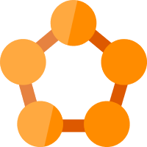
Azure Service Fabric
Containers and Microservices based Distributed Applications
Powers Azure Services like Cosmos DB, Cortana, Azure SQL, Event Hub
Stateless Services, Stateful Services, Reliable Actors, Guest Executables
Can run anywhere (other Public Clouds, On Premises)
Runs on Windows and Linux

Slide 14

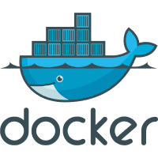
The Big Picture
Azure Kubernetes Service
Pushes Docker Image
Pulls Docker Image
Azure Container Instance
Azure Container Registry
Azure Service Fabric
Web App for Containers

Slide 15
Demo
Push an image to Azure Container Registry
Run the image on Azure Container Instance
Run the image on Web App
Run the image on Azure Kubernetes Service Cluster

Slide 16
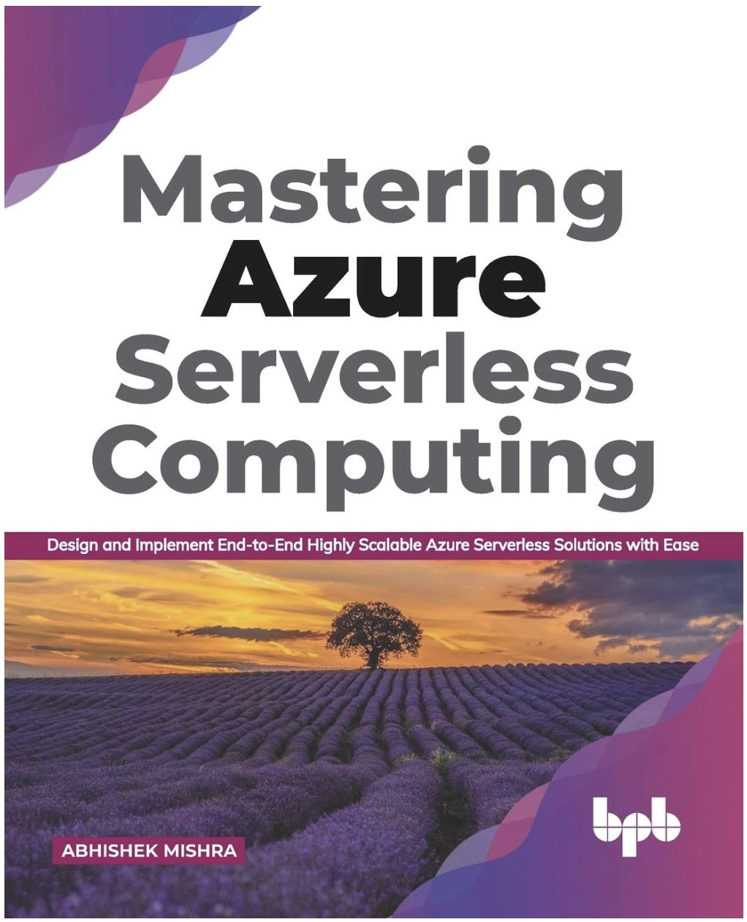
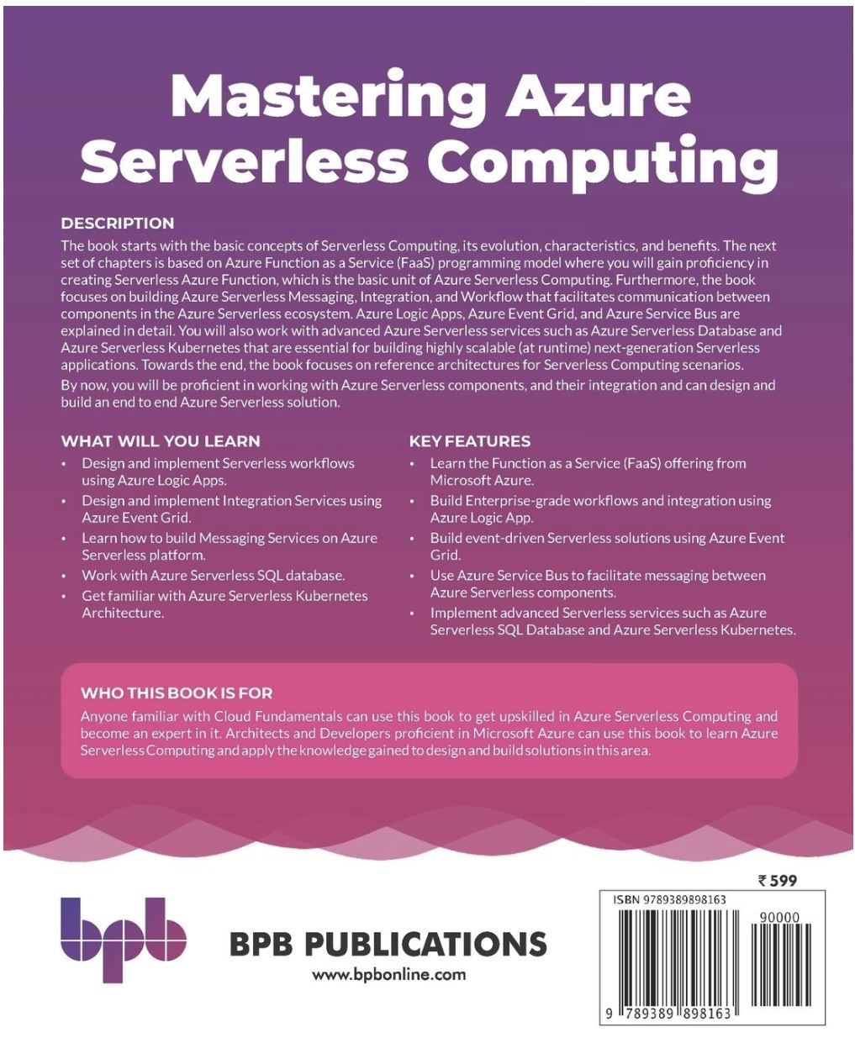
Quiz & Goodies
You stand a chance to win a Book ☺ - Claim your certificate and participate in the Quiz !!!!
If you win, books will be dispatched to your postal address.

Slide 17
WHY ARE WE DOING THESE SESSIONS?
Our primary motivations are –
We are not trainers, we are seasoned practitioner (Differentiate the monk and the priest)
Sharing of knowledge builds optimism
Builds Organizational and Social trust within the tech community
Enhances the capacity of innovation
Reciprocate what we have learned in the industry and lower the entry barriers for new comers

Slide 18
Certificates & Live Streaming
Get your certificate endorsed by the community of real practitioners, engineers and seasoned architects who run the real show!
https://www.5thir.com/
https://multicloud4u.com/streams
How to claim your certificate?
Speaker will announce a secret code during the session, key in on the form. You will receive the certificate and goodies in email
Any Query's? https://telegram.im/multicloud4u
** Paid sessions are exclusive to a user group while events and free sessions can be watched for lifetime.

Slide 19
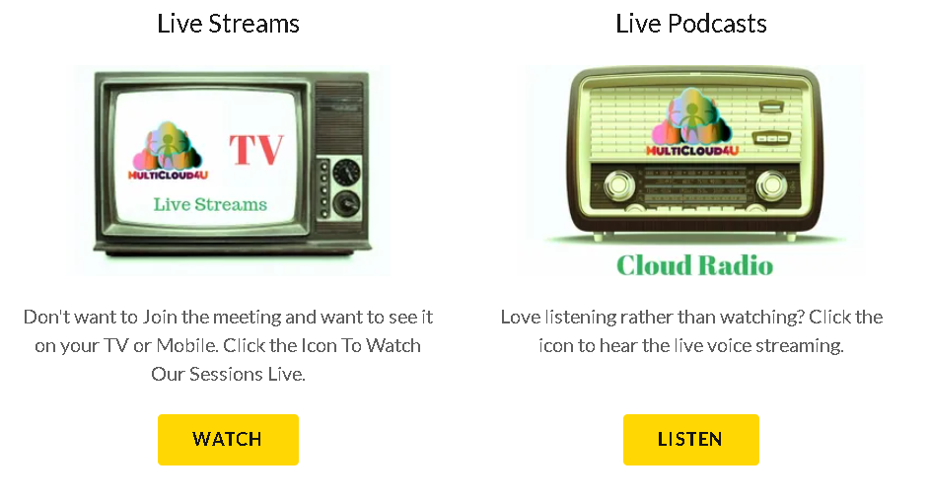
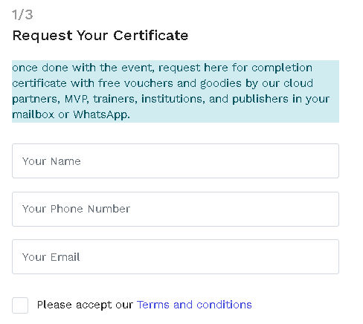
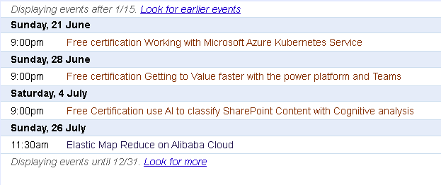
https://multicloud4u.com/streams

Slide 20
Our Inaugural Offer
Our Lifetime membership is now available for free for a limited period!
Register with us at https://multicloud4u.com/m/create-account
How to watch all our free streams and sessions?
https://multicloud4u.com/help-%26-faq
** Paid sessions are exclusive to a user group while events and free sessions can be watched for lifetime.

Slide 21
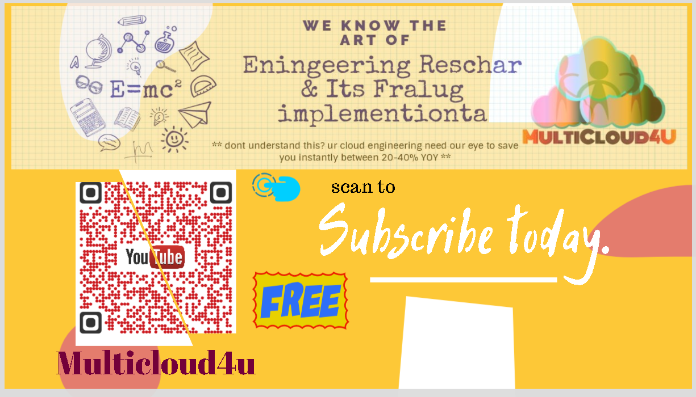

Slide 22

Queries

